Slide 1
Battleship
Bryce Gramling & Cullen Huffines

Slide 2
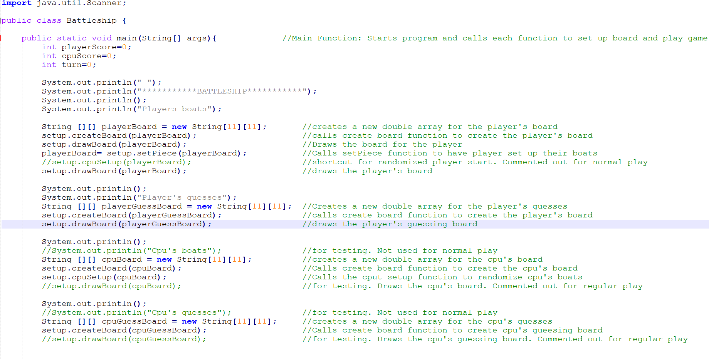
Main Function Part 1

Slide 3
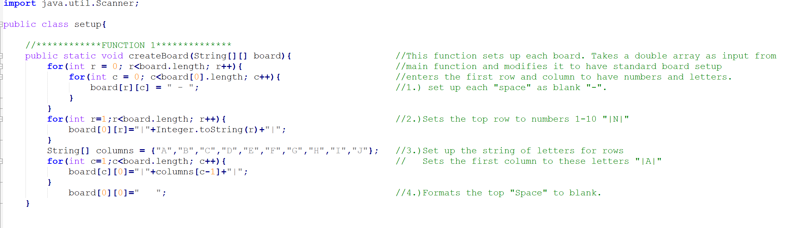
Function 1

Slide 4
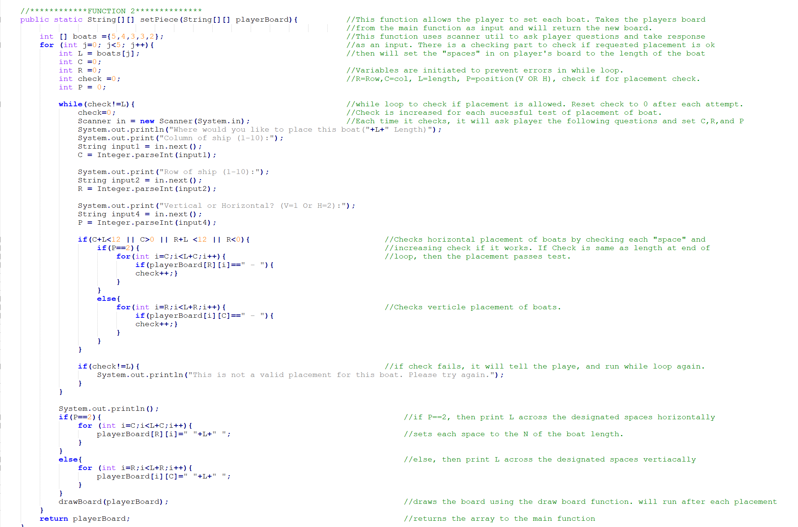
Function 2

Slide 5
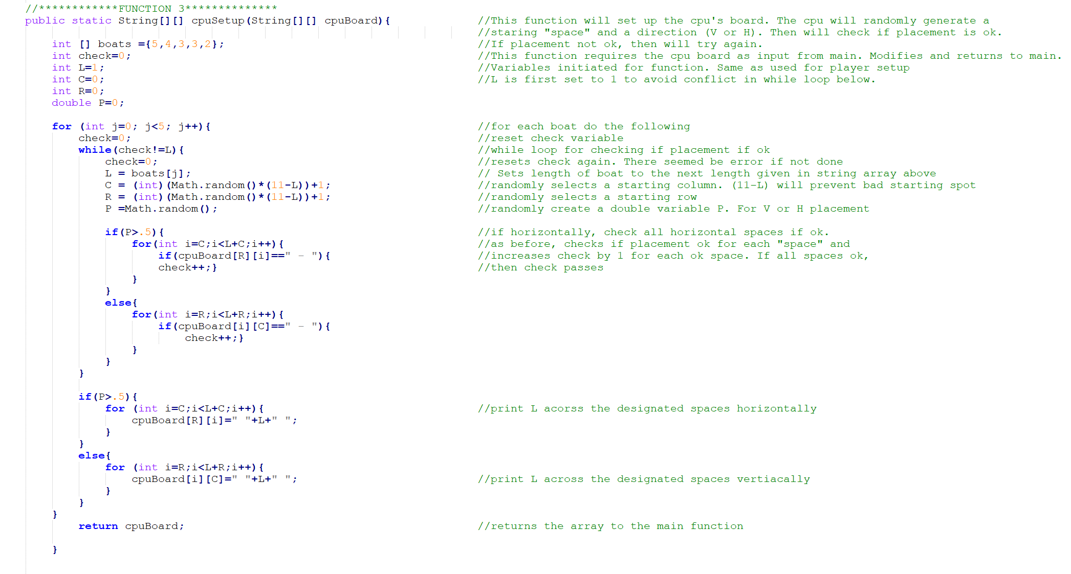
Function 3

Slide 6
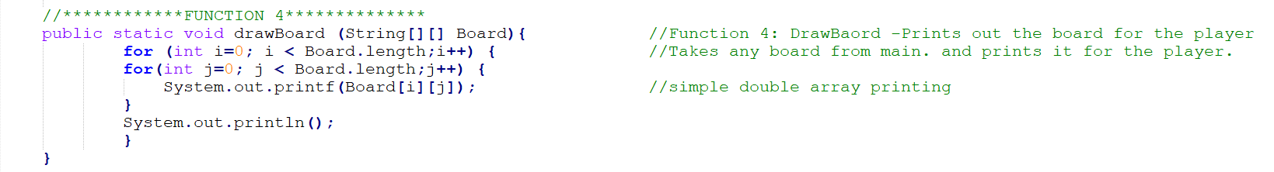
Function 4

Slide 7
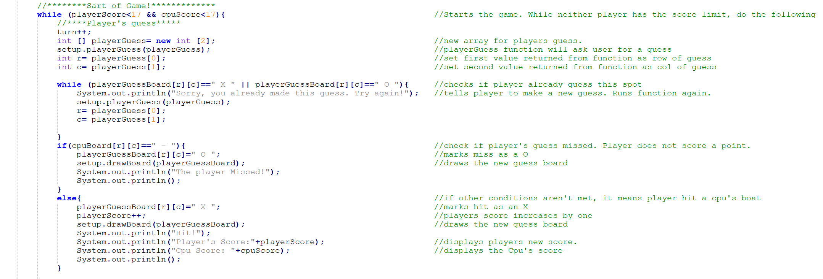
Main Function Part 2

Slide 8
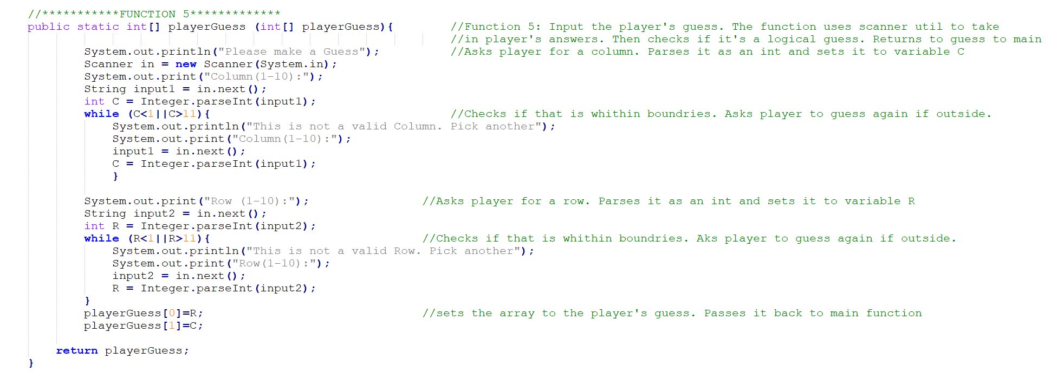
Function 5

Slide 9
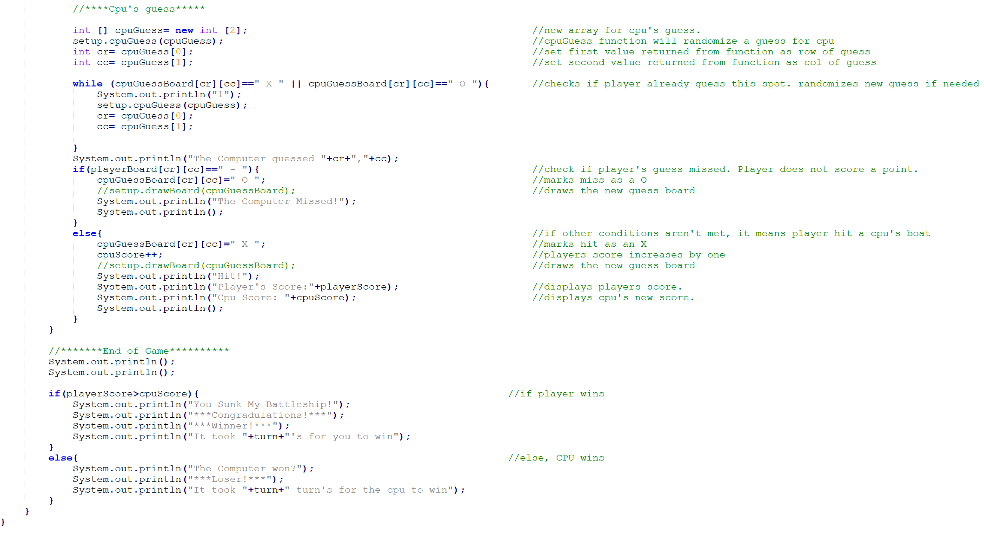
Main Function Part 3

Slide 10
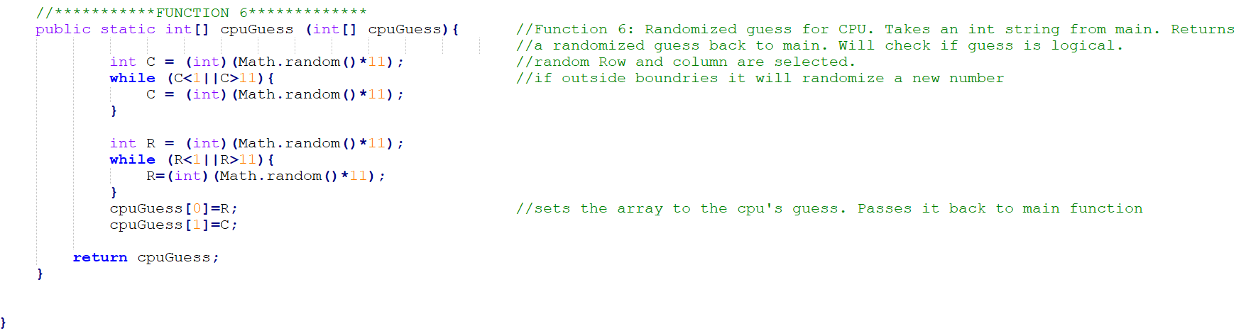
Function 6

Slide 11
Questions?
Want to play?
https://github.com/bcgramling/Battleship

